Slide 1
www.LocalCorners.com
Nick Huff Founder
Meghan Huff Owner
David Murphy Designer

Slide 2
Local Corners
Hypothesis – The Customer
More and more people are getting tired of big box stores whether it’s furniture, art, music, grocery, restaurant, and events
People are craving uniqueness, hidden gems, one of a kind, different, and the experience

Slide 3
Local Corners
Hypothesis – The Subscriber
There are thousands of people who are passionate about what they do. This could be a DIYer who builds things during the weekend, the starving artist, boutique farmer, mom and pop restaurant.
Unlike big box stores their resources are very limited

Slide 4
Local Corners
Problem
There are thousands of people who love to build and refinish furniture but struggle to sell it.
There are thousands of local starving musicians and artists who produce amazing works but the public majority does not know of them.
There are thousands of “Mom and Pop” restaurants who cook some of the best food around but marketing is not their thing. no one taste it.
There are hundreds of homesteads growing their own food and would like to sell their excess.
There are numerous events locals don’t know about unless they seek it out specifically

Slide 5
Local Corners
Why are all these people hidden in the shadows?
Step 1 – Seller Creates a Facebook Group
Days go by and few people have joined
Reality – Depression because apparently no one likes my group and therefore I am a loser
Step 2 – Seller Creates a Blog
Person goes to Wix.com or some other site.
Reality – Wow I suck at writing and its going to take years to get a following
Step 3 – Seller Builds a Website
They go to Web.com or GoDaddy, buy a domain and ask them to build them a site. YAY I have a site
Reality – I have an informational site with no functionality and the SEO and SEM sucks
Step 4 – Seller Wants to Enhance the Site
They research the cost and are deflated because while they may be passionate about what they do they are scared shitless of the cost
Reality - Deflated

Slide 6
Local Corners
Why are all these people hidden in the shadows? continued
Step 5 – Advertise through traditional methods
Person checks all the local newspapers (Folio weekly, the Beaches, Mint,) and decides to buy
Reality – They stuck their finger in the air and guessed. Problem who the hell actually takes these magazines and newspapers home for purposes other than starting a backyard fire
Step 6- I will join local events
Person attends on the weekends and gets some sales. Short term happiness
Reality – I just spent hours during the weekend when I am most productive building what I offer to have a limited number of people come see what I have to offer because the marketing and advertising sucks.

Slide 7
Local Corners
Solution
Local corners will become THE site and source of local customers to find local products, restaurants, and entertainment.

Slide 9
Local Corners Terminology and Shapes
Market to two specific types: Sponsors and Subscribers
Sponsor – This is a local business or event that rents space to artists, designers, refinishers, growers etc. Examples of a sponsor are local store fronts like ECHO, Restaruants where artists hang pictures, events such as art fares or farmers markets
Subscriber – This is a person who is renting a physical space or website space from us to post their works. This is NOT limited to just pictures. This can include Music
Local Corner
Sponsor
Subscriber
Images
music
Events

Slide 10

Main Page
The numbers represent the total subscribers and sponsors
Search By Proximity or Zip
OR
Advanced Search Phase II
Select A Local Corner
Handmade CT
1000
Refinished AVE
300
DIY
ST
500
Music
RD
600
Artist
BLVD
400
Events
PWKY
75
Farmers
Lane
26
Restaurant
Way
900
Under Construction
Detour
0
Want to join a corner?

Slide 11
Main Page
If user selects proximity the search numbers will be refined to what is available in their Area
Handmade CT
23
Refinished AVE
5
DIY
ST
6
Music
RD
7
Artist
BLVD
30
Events
PWKY
75
Farmers
Lane
2
Restaurant
Way
6
Under Construction
Detour
0
Now user can select the Corner of Interest

Slide 12
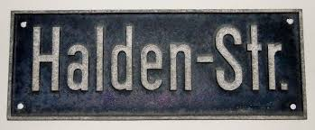
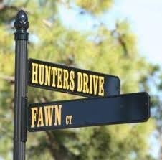

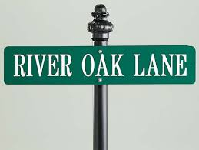
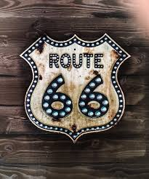
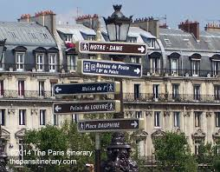
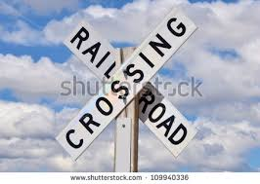
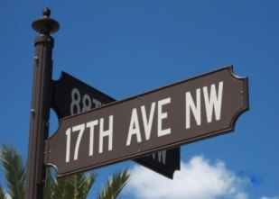
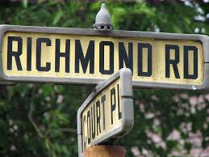
Local Corners…Examples

Slide 13
User Selects Hand Made Corner
Notice How there are both Sponsors and Subscribers. This will be important to understand the marketing channels. Customers will not notice this. Customers can click on any sponsor or subscriber
Echo
Cottage by Sea
Bobs shop
Annes Work
Nick’s work
Ooh La la Laurette
Crows work
Blakeleys work
If Customer Selects Echo which is a Sponsor see next Slide

Slide 14
Scenario 1: Customer Selects Echo which is a Sponsor
Bob
Bob
Nick
Meghan
Cliff
Cliff
Cliff
Cliff
Jimmy
Jimmy
Images of works appear. Each picture has the designers name and contact info. Sponsor may want the contact info to be the stores information

Slide 15
Scenario 2: User Selects Hand Made Corner and a subscriber
Notice How there are both Sponsors and Subscribers. This will be important to understand the marketing channels. Customers will not notice this. Customers can click on any sponsor or subscriber
Echo
Cottage by Sea
Bobs shop
Annes Work
Nick’s work
Ooh La la Laurette
Crows work
Blakeleys work
If Customer Selects Nick’s work…

Slide 16
Scenario 2: Customer Selects Nick who is a Subscriber only
Nick’s Work
Nicks work will have contact info he wants. This can include, email, phone, address, how to pay.
It will also include if he is part of any events and sponsored. Note this will make more sense in future examples

Slide 17
Scenario 3: User Selects Hand Made Corner (subscriber but is also sponsored)
Notice How there are both Sponsors and Subscribers. This will be important to understand the marketing channels. Customers will not notice this. Customers can click on any sponsor or subscriber
Echo
Cottage by Sea
Bobs shop
Annes Work
Nick’s work
Ooh La la Laurette
Crows work
Blakeleys work
If Customer Selects Crow’s work…

Slide 18
Scenario 3: Customer Selects Crow’s work who is a Subscriber and Sponsored
Crows Work
See my others works at Echo
Redirect to Echo
Crow’s work will have contact info he wants. This can include, email, phone, address, how to pay.
It will also include if he is part of any events and sponsored. Note this will make more sense in future examples

Slide 19
Scenario 4 : User Selects Hand Made Corner (Subscriber who is sponsored and is part of the Event Circuit)
Notice How there are both Sponsors and Subscribers. This will be important to understand the marketing channels. Customers will not notice this. Customers can click on any sponsor or subscriber
Echo
Cottage by Sea
Bobs shop
Annes Work
Nick’s work
Ooh La la Laurette
Crows work
Blakeleys work
This slide needs more explanation. We need to introduce the “Event Circuit” idea prior to this slide as this represents the example.
If Customer Selects Anne’s work…

Slide 20
Scenario 4: Customer Selects Anne’s work who is a Subscriber and Sponsored and Part of Event
Anne’s
work
See my others works at Echo
Redirect to Echo
If they are part of an event we have a relationship, we can redirect to the event
Anne’s work will have contact info he wants. This can include, email, phone, address, how to pay.
It will also include if he is part of any events and sponsored. Note this will make more sense in future examples

Slide 21
A Basic Blue Print for the 4 Scenarios Goal: Is it possible for each click to behind the scenes act a redirect? Almost like a Search on Google to boost traffic and get us up higher
Crows
Sponsored and Subcriber
Echo
Nick
Subcriber Only
Annes
Subscriber
Sponsored Event

Slide 22
Main Page – User Selects Local Corner. If Mobile App uses proximity, if not enter Zip
Search By Proximity or Zip
OR
Select A Local Corner
Handmade CT
1000
Refinished AVE
300
DIY
ST
500
Music
RD
600
Artist
BLVD
400
Events
PWKY
75
Farmers
Lane
26
Restaurant
Way
900
Under Construction
Detour
0

Slide 23
Users Selects Music RD.
Ouija
Jobe
Mom
Dad
Muscian can upload X number of songs. Contact info to purchase Music etc

Slide 24
Users Selects Music RD.
Jobe
Muscian can upload X number of songs. Contact info to purchase Music etc
If user is playing at a Bar or restaurant they can list and update here. If the local bar is a paying location then….

Slide 25

Users Selects Music RD.
Jobe
Musician can link directly to the subscriber bar

Slide 26
Users Selects Music RD.
Jobe
If Musician is playing a paying bar and an paying event

Slide 27
Users Selects Music RD.
Jobe
If user selects the Bar it will redirect to Bar

Slide 28
Users Selects Music RD.
Who is Bob? This doesn’t make sense/needs additional clarification
Jobe
12/15/15
Ouija
1/5/16
Bob
3/7/15
Bob is not a paying subscriber. This maybe advantageous to us. Bob may notice he can upload his music
If Musician is playing a paying bar and an event. Bar can list all musicians and dates. If other musicians are subscribers It can link to their music Corner by clicking

Slide 29
How to grow the business
Phase 1
Business Development
Sales
Affiliate program
Viral Marketing
Existing Platforms

Slide 30
How to Grow the Business – Business Development
Meet with Sponsors and subscribers and tell them your story
Help them understand and see their pain
Show them what we are doing. Individually you would have to pay an army to get found on the internet.
Cooperatively we will be your means to be found
Start with a subset from each corner you love and help them by offering it for free.
Ask friends in different states their favorite local places in our corners.
Goal: To get into the majority of states

Slide 31
Sales
Go to events, listen to music, meet the people and talk with them.
Give them our cards. This will direct them to the site for them to become either a subscriber or Sponsor

Slide 32
Affiliate Program
Build a relationship with business card manufacturer. Help her understand I need a huge discount for new subscribers because we are going to give it to them for free. You then will get to charge for renewals. I am introducing you to new customers.
For subscribers provide them 100 business Cards for free

Slide 33
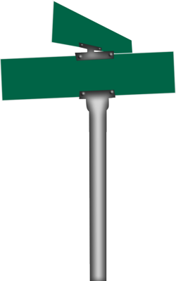
Affiliate program
Name:
Phone:
Email:
Website: www.localcorners.com
Search:58690
I want to go with a random generated number so it takes people to the main page. The user will be able to search off the number.

Slide 34
Viral Marketing
As the illustrations in the scenarios above showed there are numerous opportunities to create loops.
Sponsors actually have an interest in their renters subscribing because creates more opportunities for people to go to their corner, more foot traffic
Subscribers will want people they rent from to be a sponsor because of the name

Slide 35
Existing Platforms
This one is all you David!!!

Slide 36
Blogs
Find the blogs that focus on our corners.
Reach out to them…especially if they actually have successful advertising on their site. Need to determine what is successful advertising. Need to figure out their following

Slide 37
Search Phase I
Users can choose to either start search by
Zip Code or proximity
Tracker Number
Or By Corner
Once a corner is selected they will need to input
Zip, proximity or tracker

Slide 38
Advanced Search Phase II
As the corners grow, there will be too much for people to search and our phase I will become obsolete.
To accommodate this we will need to enhance our search engine.
When sponsors and subscribers purchase, we need to capture what their genre is
The same applies to customers

Slide 39
Advanced Search Phase II - Keywords
Select Corner
Keyword searches within Corners
Ex: Music = jazz, reggae, trance, etc
EX: Refinished = Shabby chique, French, rustic, contemporary, traditional
Handmade = wood, cement, cloth, metal
Art = abstract, contemporary canvas, paper, sketch
Restaurant = American, italian, bistro, gas pub
DIY – wood, cement, metal
Events – free, fee, active, non-profit, festival
Farmers – Meat, veg, fruit, dairy
Must want to set up distribution for the customer (customer comes out weekly to pick up their “order” or customer meets them at a local farmer’s market each week.

Slide 40
Advanced Search Phase II - Keywords
Capture all successful keyword searches
Capture all failed keyword searches, bounce against a spellcheck. Add failed searches to auto correct
Add missed keywords to database of keywords
Create database off of words subscribers and sponsors use to describe their corners

Slide 41
Advanced Search Phase II - Pricing
Pricing should be based on ranges
However, the price ranges should be based on the pricing ranges within the Corners
EX – Handmade CT in Jacksonville has 100 total subscribers and sponsors. There are numerous prices but none are less than $50 and none more than $1000. Do not have the ability to select $2000 or $5

Slide 42
Advanced Search Phase II – City
Pretty Self-Explanatory
However, what about none official parts of town like “5 Points, Riverside, the Beach”
These should be defined as regions or neighborhoods of the cities similar to what Open Table does; you type in the city and it gives you the option to search by neighborhood.

Slide 43
Advanced Search Phase II - State
Duh

Slide 44
Advanced Search – Phase III – The algorithm
Track users click history from corner to corner. This will allow us to see patterns
Use the pattern to design a “Make a Day Square”
Make a Day Square uses an algorithm to recommend a day plan for them to hit up local corners they are interested in based on what they have clicked on. Probably need cookies enabled

Slide 45
Phase III – Community Sale
Create a community sale (once a quarter, once a year?)
This is when subscribers and sponsors can have a sale. Items will be on display at their houses, galleries, store fronts, etc.
Request an RSVP
Send an email to all customers with logins notifying them of the event.

Slide 46
Criteria for Corners - Handmade
Must be made locally
Can not be a chain or franchised
Must be constructed from scratch but can utilize repurposed materials, i.e. legs from an old table but table top was handmade.
Should there be a minimum sales fee? I ask this because even though it may drive away some subscribers it may also allow us to maintain better subscribers

Slide 47
Criteria for Corners - Refinished
Can not be part of chain or franchise
Original piece must be modified
Should there be a minimum sales fee? I ask this because even though it may drive away some subscribers it may also allow us to maintain better subscribers

Slide 48
Criteria for Corners - DIY
Maybe DIY should fall into Handmade and Refinished. -Yes, agree. Also not sure we should have a DIY category because this can create a whole other segment with crafts like knitting, jewelry, etc.

Slide 49
Criteria for Corners - Music
Must be original music not redone music
They can play songs from others but they must upload original only

Slide 50
Criteria for Corners - Artists
No repainted images. Original works of art only

Slide 51
Events Parkways
Must emphasize supporting the local corners
This may be premature but to give back to the community if the events are non-profit maybe we could allow them to post for free.
This would not be an immediate successful post. We need to validate them. For the time being this might need to be manual
Need more clarification. I don’t understand what this is

Slide 52
Criteria for Corners - Restaurants
No chains
No Franchise's
David Provide your 10 favorite Local Restaurants

Slide 53
Criteria for Corners -Farmers Lane
Local Farmers only
No corporations

Slide 54
How much to charge?
To best figure out what to charge, I’d like to know what the average cost per user is going to be.
Cost to load pictures, link them to other subscribers, corners…their content
Along with content what is our cost per month to support credit card transactions and maintain PCI…I would like to know this per user.

Slide 55
Main Page…How to Join a corner
Search By Proximity or Zip
OR
Advanced Search Phase II
Select A Local Corner
Handmade CT
1000
Refinished AVE
300
DIY
ST
500
Music
RD
600
Artist
BLVD
400
Events
PWKY
75
Farmers
Lane
26
Restaurant
Way
900
Under Construction
Detour
0
Want to join a corner?

Slide 56
Main Page…How to Join corner
All subscribers and Sponsors will need to provide some information that is agnostic.
Demographic information must haves:
First Name, Last Name, City State, Zip code, phone number, email address, address
Demographic Nice to Have’s
Age, Sex
How they heard about us. I tend to wonder if this question is located within the demographic information they will be more likely to fill it out
Create Username and password (need security questions to retrieve forgotten password)
Billing information
Typical billing info. Need to ask, do you want to be charge monthly , quarterly, or annual? Just like insurance we should provide what will look like a discount if they purchase quarterly, or annual. This is why we need to know cost per person.

Slide 57
Main Page…How to Join corner
Are you a Sponsor or are you a subscriber?
Sponsor What is a sponsor (When they click on the link it will provide definitions)
Subscriber What is a subscriber (When they click on the link it will provide definitions)

Slide 58
How to Join…Handmade
Step 1
Do you think you like a monthly subscription or an annual subscription? And what type of account do you want. (We need to figure out if a tiered structure makes sense). Don’t worry you can change our mind after you load your works.
Step 2
How many pictures do you want to load? (show pricing model)
Lets load some pictures of your works. You may want to take a look at our free video tutorial on how to stage your furniture www.howtostage.youtube
(after the video is complete)
Medium – Wood, metal, concrete, fabric, etc
Style – Shabby Chic, Rustic, Contemporary, Modern, antique, elegant, traditional, etc.
Type – Chairs, desk, Dressers, coffee tables, dining tables, benches, etc.

Slide 59
How to Join…Handmade cont
Step 3
Now that you have loaded your pictures we want you to tell us about your works. You will repeat this process for each work. If you loaded multiple pictures for 1 work just let us know which ones apply
Dimensions
Description, limited to XXXwords what inspired you
Step 4
As you know you provided us your contact information. How do you want potential customers to contact you? (They will select applicable boxes) Are you ok with appointments and private sales? Only registered customers will be able to see appointments and private sales
Repeat steps 3 and 4 for your pictures

Slide 60
How to Join…Handmade cont
Step 5
Congratulations your works are ready to be posted for locals to see!
Do you want a monthly subscription or an annual subscription. Annual subscriptions will save you some Money!!!
Step 6
Load your billing information
Billing information
Typical billing info. Need to ask, do you want to be charge monthly , quarterly, or annual? Just like insurance we should provide what will look like a discount if they purchase quarterly, or annual. This is why we need to know cost per person.

Slide 61
How to Join…Refinished cont
Same as handmade

Slide 62
How to Join…DIY
Same as handmade
I think we need to re-think this section. DIY can be so many different things.

Slide 63
How to Join…Music
Step 1
Do you think you like a monthly subscription or an annual subscription? And what type of account do you want. )We need to figure out if a tier structure makes sense.) Don’t worry you can change our mind after you load your works.
Step 2
How many Original Songs do you want to load? (show pricing model)
Before we load your music, do you want to post a picture of you and or the band?
Lets load some of your original music (original only)
Type – Hardrock, blues, Jazz
Inspiration – What music inspired your songs?

Slide 64
How to Join…Artist
Step 1
Do you think you like a monthly subscription or an annual subscription? And what type of account do you want. )We need to figure out if a tier structure makes sense.) Don’t worry you can change our mind after you load your works.
Step 2
How many pictures do you want to load? (show pricing model)
Lets load some pictures of your works. You may want to take a look at our free video tutorial on how to stage your furniture www.howtostage.youtube
(after the video is complete)
Medium – Canvas, ceramic, metal, paper, glass
Style – abstract, contemporary, dotism, etc
Type – wall art free standing

Slide 65
How to Join…Events
Step 1
Do you think you like a monthly subscription or an annual subscription? And what type of account do you want. )We need to figure out if a tier structure makes sense.) Don’t worry you can change our mind after you load your works.
Step 2
Do you host reoccurring events? If so how many? (show pricing model)
Lets load your events into our calendar. If you want you can load 2 pictures per event as well. With each event we would like you to provide a brief description of your event. Also select what type of event it is.
Arts, Crafts, furniture, music, farmers, Festival, Non-Profit, athletic. If you don’t see the type of event
Don’t see your type of event? No problem. Just type it in the space below
Step 3
Do you have space you would like to rent to potential exhibitors? If so make sure you add your contact information so we can help you fill your booth spaces.

Slide 66
How to Join…Events Cont
Step 4
As you know you provided us your contact information. How do you want potential customers to contact you? (They will select applicable boxes)

Slide 67
How to Join…Restaraunts
Step 1
Do you think you like a monthly subscription or an annual subscription? And what type of account do you want. )We need to figure out if a tier structure makes sense.) Don’t worry you can change our mind after you load your works.
Step 2
Lets go ahead and load your menu
Step 3
Now that we have loaded your menu lets load some pictures of entree’s.
Step 4
Tell us a little bit about restaurant. Things you might want to include could be how long you have been in business, what has been your inspiration and maybe something that sets you apart from others

Slide 68
How to Join…Farmers
Step 1
Do you think you like a monthly subscription or an annual subscription? And what type of account do you want. )We need to figure out if a tier structure makes sense.) Don’t worry you can change our mind after you load your works.
Step 2
What are you selling:
Fruits – Oranges, apples, etct
Vegetable – Broccoli, potatoes
Eggs
Chicken, Beef, Pork or other
Step 3
Lets load a couple of pictures of what you want to sell
Step 4
Where can people purchase your produce
Your house Events (If the event has a website, provide that to us. If not let us know who it is).

Slide 69
How to Join a Local Corner…Incomplete Information
Anytime a subscriber or sponsor creates a username and password, but for whatever reason does not complete the entire process, we need to email and/or text them their remaining steps

Slide 70
“Make a Day”
The idea behind the “Make a Day” corner is to provide a virtual event planning tool for anyone. Another phrase used is a scavenger hunt
Ever wake up on a Saturday and ask your wife what do you want to do? The typical response is “I don’t know what do you want to do?” This can go on for hours

Slide 71
“Make a Day” continued
Similar to Gilt, One Kings Lane, and other locations that request customers information we will do the same.
When a person logs in we will track each and every click they make. We will track their frequency in corners and how long they are there. Over time we will be able to identify patterns. From there we can offer two “Make a Day” options. One that fits their pattern or one to get them out of their comfort zone.

Slide 72
The Local Corners Event Day (Community Sale)
As we build subscribers and our Corners become more comprehensive, we will create a Community Sale.
We will send out communication to specific corners (Handmade and Refinished) for example telling them we would like you to participate in our community sale. We will provide a date and time. If they say they are interested we will add them to the community sales list.
Next we will email all customers about the community sale. They can go and visit whomever they want during that time.

Slide 73
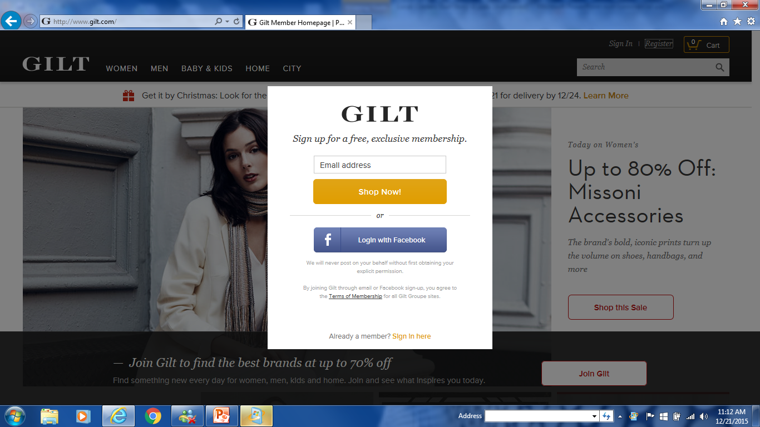
Customer Login…add Zip Code Field

Slide 74
Customer Login…Terms
See Word Doc Local Corners Terms

